Slide 1
S J C INSTITUTE OF TECHNOLOGY DEPARTMENT OF COMPUTER SCIENCE AND ENGINEERING
The Project Review
On
“Project Title”
PRESENTED BY
Student Name USN
Student Name USN
Student Name USN
Student Name USN
UNDER THE GUIDANCE OF
Guide Name Prof. Girish BG Dr. ANITHA T N
Designation ASSISTANT PROFESSOR PROFESSOR AND HOD
CSE,SJCIT CSE, SJCIT CSE,SJCIT

Slide 2
CONTENTS
I. ABSTRACT
II. INTRODUCTION
III. LITERATURE SURVEY
IV. PROBLEM IDENTIFICATION & DEFINITION
V. SIGNIFICANCE & RELEVANCE OF WORK
VI. OBJECTIVES AND METHODOLOGY
VII. PLAN OF EXECUTION(Gantt Chart)
VIII.SRS

Slide 3
ABSTRACT
Parkinson's disease attacks elder population in this world, with one of the main symptoms of this disease being resting tremor. Until now, Parkinson's disease information acquisition can only be done through patients' visits to clinics or hospitals, whereas the aspects of the disease are also shown during in-between those visits.
In this project, we develop an electromyography (EMG) based remote-monitoring system in order for patients are able to be
checked more frequently and the results are in always-renewed information. This monitoring system utilizes NodeMCU as the compiler component and ESP8266 WiFi module and web server.

Slide 4
INTRODUCTION
NEUROLOGICAL disorders, together with Parkinson’s malady (PD), Alzheimer’s, and brain disorder, deeply have an effect on the lives of patients and their families.
PD affects over one thousand people in North America alone. Moreover, associate degree aging population suggests that this range is predicted to rise as studies counsel chop-chop increasing prevalence rates when the age of sixty . In addition to exaggerated social isolation, the monetary burden of metallic element is important and is calculable to rise within the future currently, there's no cure, though medication is obtainable providing vital alleviation of symptoms, particularly at the first stages of the malady .
Most people with Parkinson’s (PWP) malady can thus be well obsessed on clinical intervention. Parkinson could be a disorder and happens owing to lack of dopamine neurons. These dopamine neurons manage all body movements. Parkinson patients have issue in doing all daily routine activities, and even have disturbed vocal fold movements.
Victimization voice analysis malady is diagnosed remotely at an early stage with a lot of reliability and economic way. Diagnosis of Parkinson malady is extremely tough and no diagnostic science laboratory tests are accessible. Medical specialty tests and brain scans are done to diagnose it.

Slide 5
LITERATURE SURVEY

Slide 6
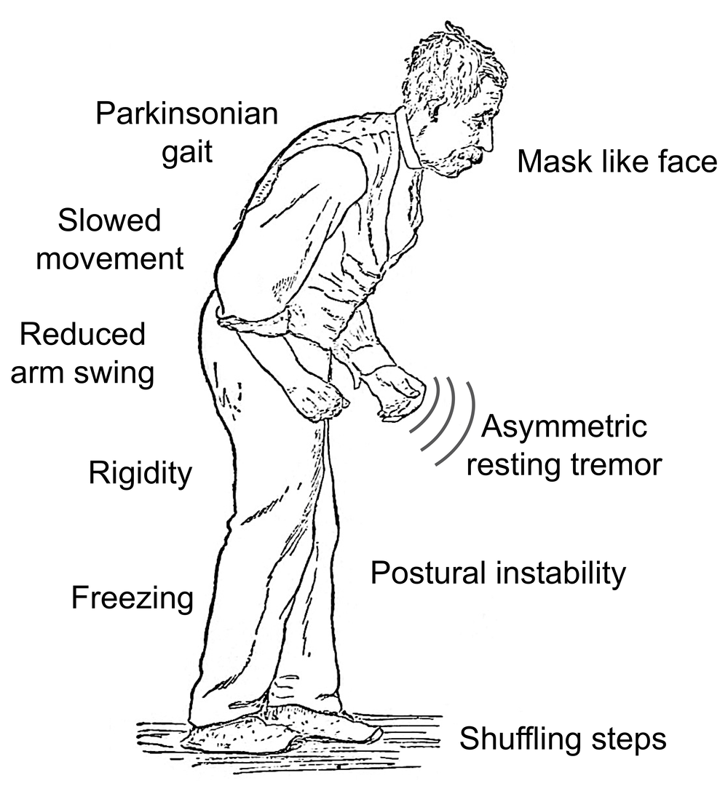
PROBLEM IDENTIFICATION & DEFINITION
Parkinson's disease attacking 1 percent of the elder population in this world, with one of the main symptoms of this disease being resting tremor. Until now, Parkinson's disease information acquisition can only be done through patients' visits to clinics or hospitals, whereas the aspects of the disease are also shown during in-between those visits.

Slide 7
SIGNIFICANCE & RELEVANCE OF WORK
Prior to this research, there were also several notable researches regarding the use of home monitoring and remote monitoring methods and devices for Parkinson’s disease patients. The first publication was about a computer-based exercise to support Parkinson’s disease diagnosis and it was first published in 2002 [5]. Hereafter, in 2008, a pedometer based wearable step counter was designed using a force sensing resistor, aiming to record expansion activity of the gastrocnemius muscle—outermost muscle of shank—to see the characteristics of foot movement and to count the number of steps a Parkinson’s disease patient can make during a certain period of time [6]. This research was then followed in 2009 by a design of a tri-axial accelerometer-based gait sensor to measure accelerations carried out from walking by several Parkinson's disease patients and people in good health condition as the subject of research

Slide 8
OBJECTIVES & METHODOLOGY
Power supply
EMG sensor
Nodemcu
Wi-Fi
Button
Buzzer
LCD Display

Slide 9
OBJECTIVES & METHODOLOGY
To develop a simple, painless and reliable method to detect Parkinson’s disease at an early stage is very important to patients, doctors.
Doctors want to help patients early, and scientists want to select patients for their research who will help in prescribing of better drugs through notifications.
To detect electrical activity of hand muscles during hand activity will help in early detection of this disease.
To study evaluated whether changes in the electromyography (EMG) pattern during rapid point-to-point movements in individuals diagnosed with PD.
User can set time table of medicine by himself able to be trusted for patients & old age people. Comfortable for old age people and provide healthy life for patients who are to regularly take medicines.

Slide 10
PLAN OF EXECUTION
TASK ID | TASK NAME | START DATE | END DATE | DURATION in days | WEEKS
 |  |  |  |  | 1 | 2 | 3 | 4 | 5 | 6 | 7 | 8 | 9 | 10 | 11 | 12 | 13 | 14 | 15
1 | Research and Analysis | 10/01 | 10/24 | 24
2 | Requirements collection | 10/25 | 10/29 | 5
3 | Design | 11/01 | 11/13 | 13
4 | Review | 11/13 | 11/15 | 3
5 | Development | 10/25 | 12/20 | 57
6 | Testing | 12/10 | 12/22 | 13
7 | Implementation | 12/10 | 12/15 | 6

Slide 11
SRS

Slide 12
THANK YOU

